Slide 1

String & Array
Your success is our success
Funny Gorilla 诙猩猩
Notes:
Notes for title slide

Slide 2
String
a data type, store a sequence of characters
immutable, a String can not be changed.
If you attempt to do so, Java will create a new object that contains the modified character sequence
String uses up lots of memory, for it is immutable.
String Pool, a part of JVM to store literal, for reuse string
String name = “FunnyGorilla”;
String name = new String (“FunnyGorilla”);

Slide 3
Operations

Slide 4
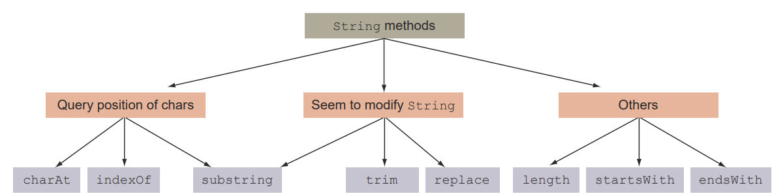

Slide 5
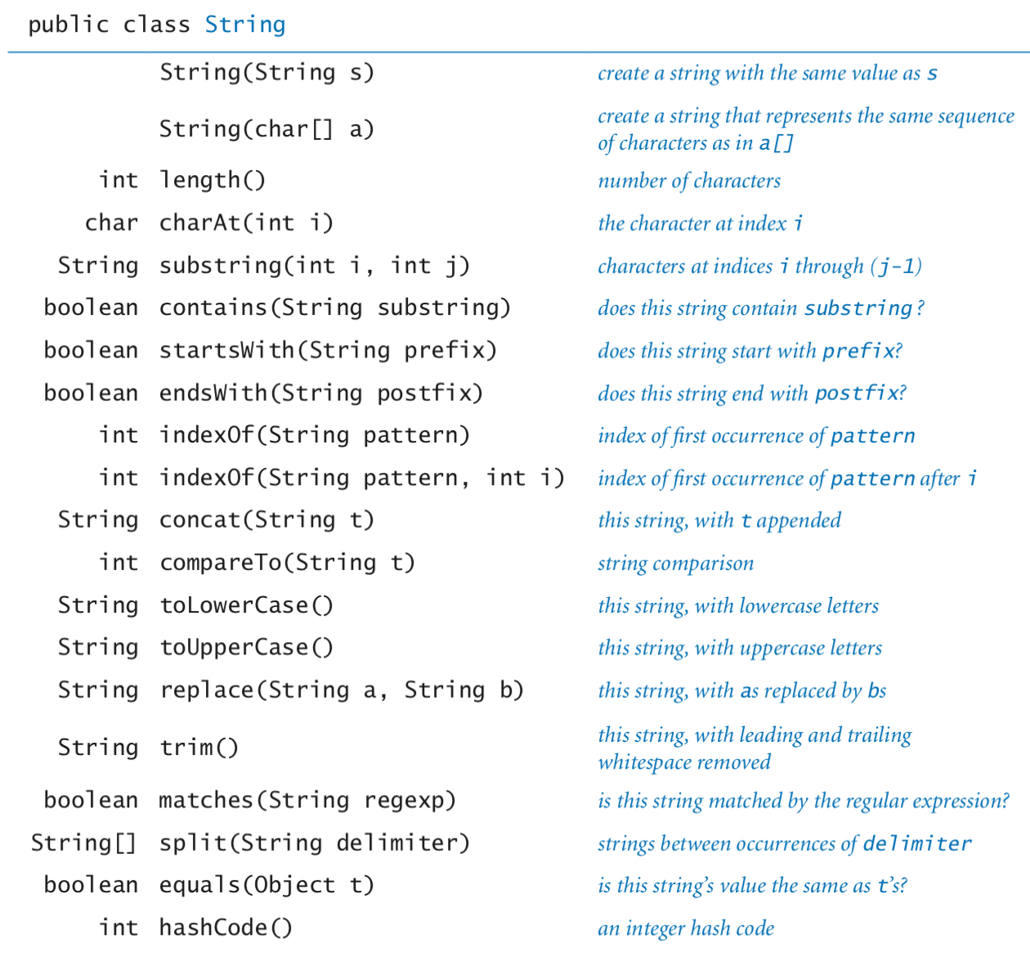

Slide 6
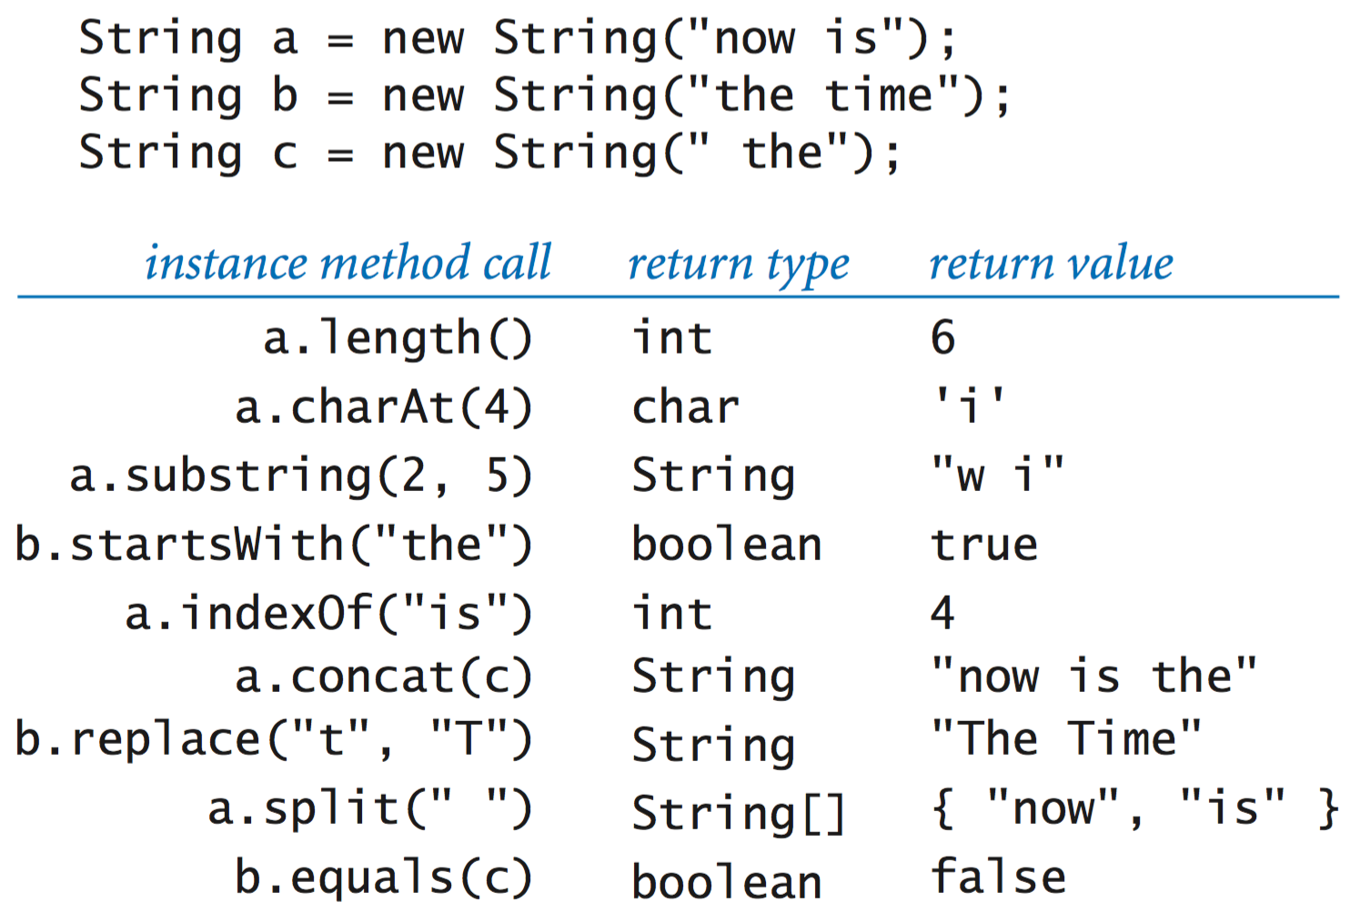

Slide 7
Array

Slide 8
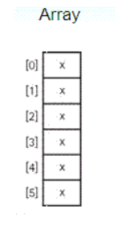
Array, an area of memory on the heap with space for a designated/fixed number of elements.
In Java, an array is also an object
The elements are indexes and are referenced using the form var[index]
String: implemented as an array of chars
StringBuilder: implemented as an array of chars, replaced with new bigger array.

Slide 9
Create an array
Create an array:
Int[] myInt = new int[3]; // empty array
Initialize array:
myInt[0]=44; myInt[1]=45; myInt[2]=46;
Create & initialize an array:
Int[] myInt = new int[] {44, 45, 46};
Int[] myInt = {44, 45, 46}
String[] myStrs = {“How are you?”};
Object[] objs = myStrs;

Slide 10
Using Array – java.util.Array
Sorting
Int[] numbers = {6,9,1};
Array.sort(numbers); => {1,6,9}
Searching
Int[] numbers = {2,4,6,8}
Array.search(numbers, 2); //0
Array.search(numbers, 4); //1
Varargs
String[] args
String args []
String… args

Slide 11
ArrayList
  ArrayList overcomes shortcoming of Array.
  It can change the size at runtime as needed.
  ArrayList list1 = new ArrayList();
  ArrayList list2 = new ArrayList(12);
  ArrayList list3 = new ArrayList(list2);

Slide 12
Using ArrayList
  add()
  Remove()
  Set()
  Clear()
  isEmpty()
  Size()
  Contains()

Slide 13
Reference
https://www.callicoder.com/java-arraylist/
https://introcs.cs.princeton.edu/java/31datatype/

Slide 14

Your success is our success
Contact
Mail: info@funnygorilla.com.au
Linkedin: https://mt.linkedin.com/in/songqing-gu-2ba9034b/de
Web Chat: FunnyGorilla
Phone: 0420891343

